Slide 1

Embracing pluralism fostering seed systems development; Experiences of WUR
Marja Thijssen & Walter de Boef, 28 June 2023
Image courtesy: Vecteezy.com

Slide 2
Content
Need for functional seed systems
Complexity of seed systems
Stakeholders in seed value chains
Private sector development
Examples of seed sector interventions
WCDI seed systems cluster and projects

Slide 3
Need for functional seed systems
Genetic resources management
$$ upstream investments:
Research and technology development
Variety development
EGS production
Functional seed systems to deliver high quality seed of improved varieties to farmers
X
Seed multiplication
Seed distribution and marketing
$$ downstream investments:
Linking farmers to value chains and markets
Seed use

Slide 4
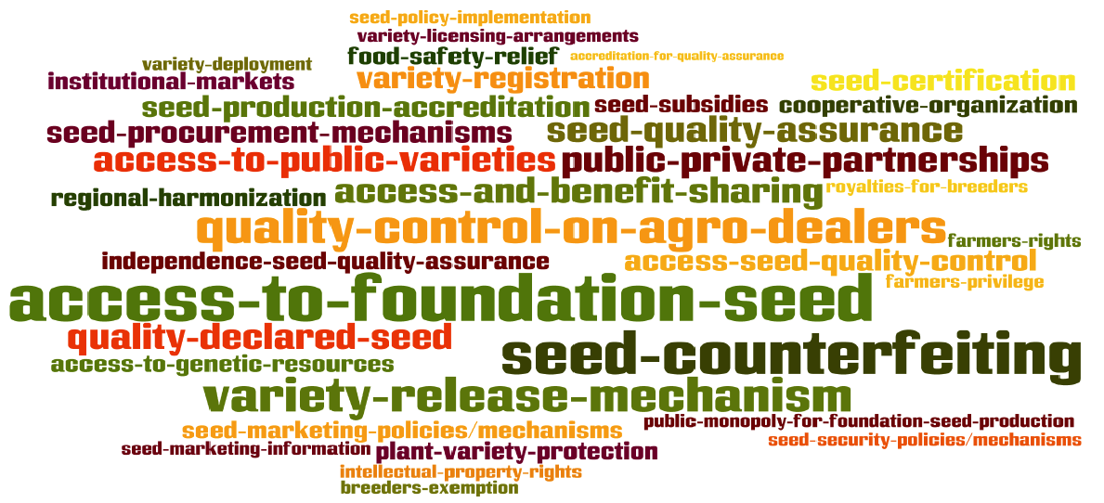
Complexity of seed systems
In addition, seed needs to be available at the right time, at the right place, in the required quantity, and at an affordable price

Slide 5
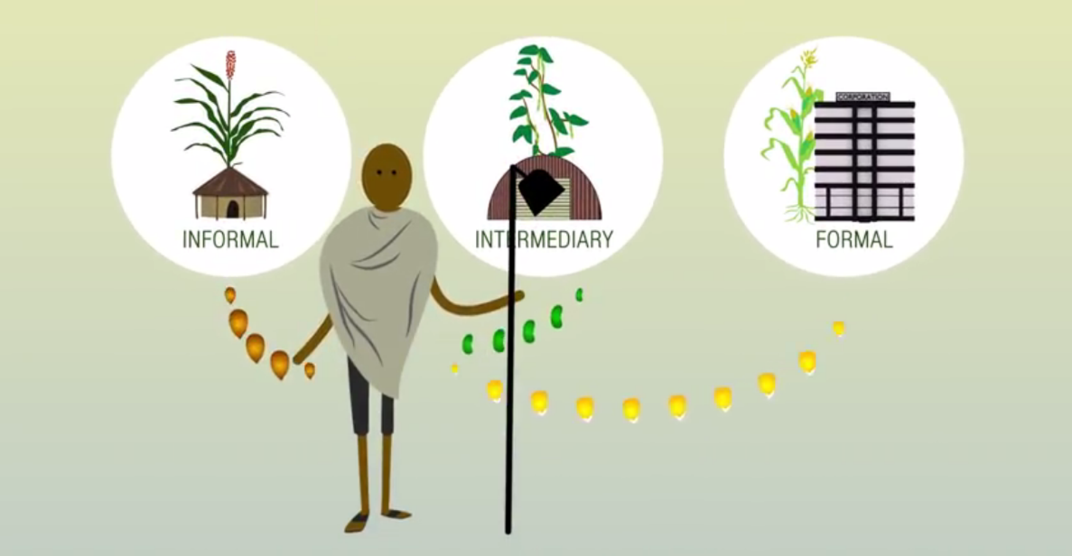
Dealing with seed systems complexity
What are preconditions for successful seed interventions?
How to take a sector-wide approach recognizing the value of different seed systems?
Integrated Seed Sector Development
https://www.youtube.com/watch?v=4BQxR5vdvZw

Slide 6
Stakeholders in seed value chains
Crops with private breeding, e.g. hybrid vegetables
Variety development
Early generation seed production
Seed multiplication
Seed distribution & marketing
Genetic resources management
Seed use
International seed companies address all operations in SVC
CGIAR institutes
National research institutes
Domestic/ local seed businesses
Agro-dealers or extension
Crops with public breeding, e.g. beans or cassava

Slide 7
Private sector development
Profit is a strong incentive for sustainability
Supporting and collaborating with entrepreneurs at different levels
Create an enabling business environment
Type of entrepreneurs | Crops | Interventions
Community-based businesses | Cassava, beans | Support technical and management capacities and link to key stakeholders for inputs and markets
Domestic seed enterprises | Maize, wheat | Support development business plans and marketing strategies
International seed companies | Vegetables | Support establishment of variety demonstrations

Slide 8
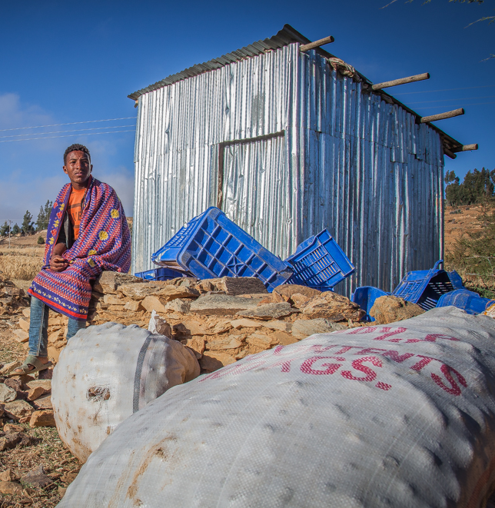
Example: Potato see system in Ethiopia
Challenge:
Low potato tuber quality
Approach:
Support a system of disease-free early generation seed potato production with regional research organizations
Support farmer groups to produce high quality seed potato as a local business
Pilot potato seed mini-tuber production in farmers’ cooperative screenhouses
Raise awareness on seed quality assurance directive and strengthen implementation capacity
Support development of value chain for Hybrid True Potato Seed (HTPS)
Photo: FourCorners

Slide 9
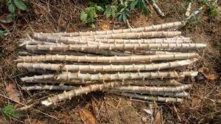
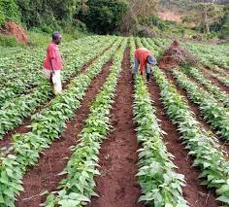
Example: Cassava seed system in Uganda
Challenge:
Improved varieties remain on the shelf
Approach:
Link with research to introduce new disease resistant varieties
Link research to seed multipliers for sustainable access to early generation cassava seed
Promote local seed businesses in cassava seed production and marketing
Adapt and implement system and regulations for quality declared cassava seed
Raise farmers’ awareness on variety attributes and benefits of using quality cassava seed
Photos: ISSD Uganda; IITA Basics

Slide 10
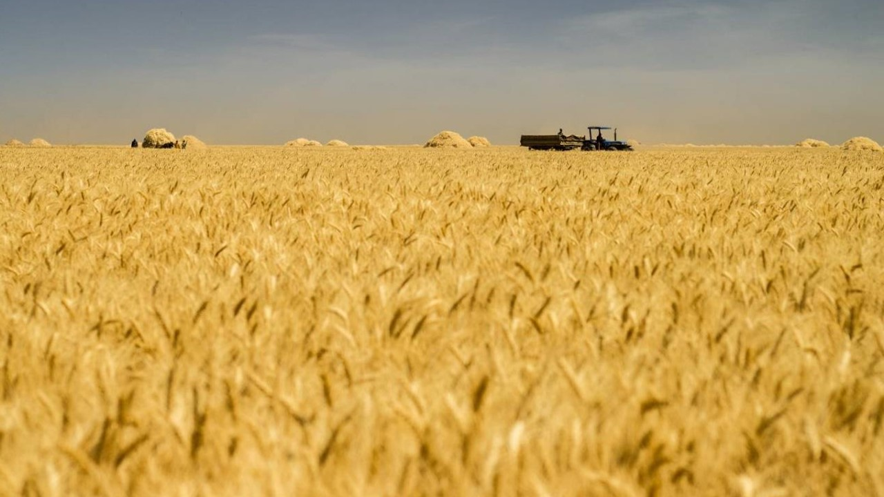
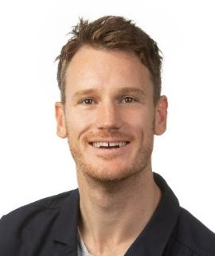
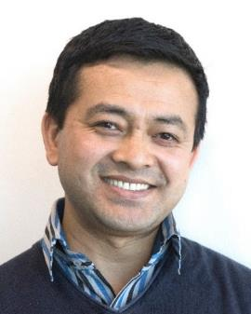
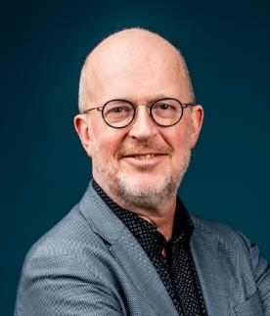
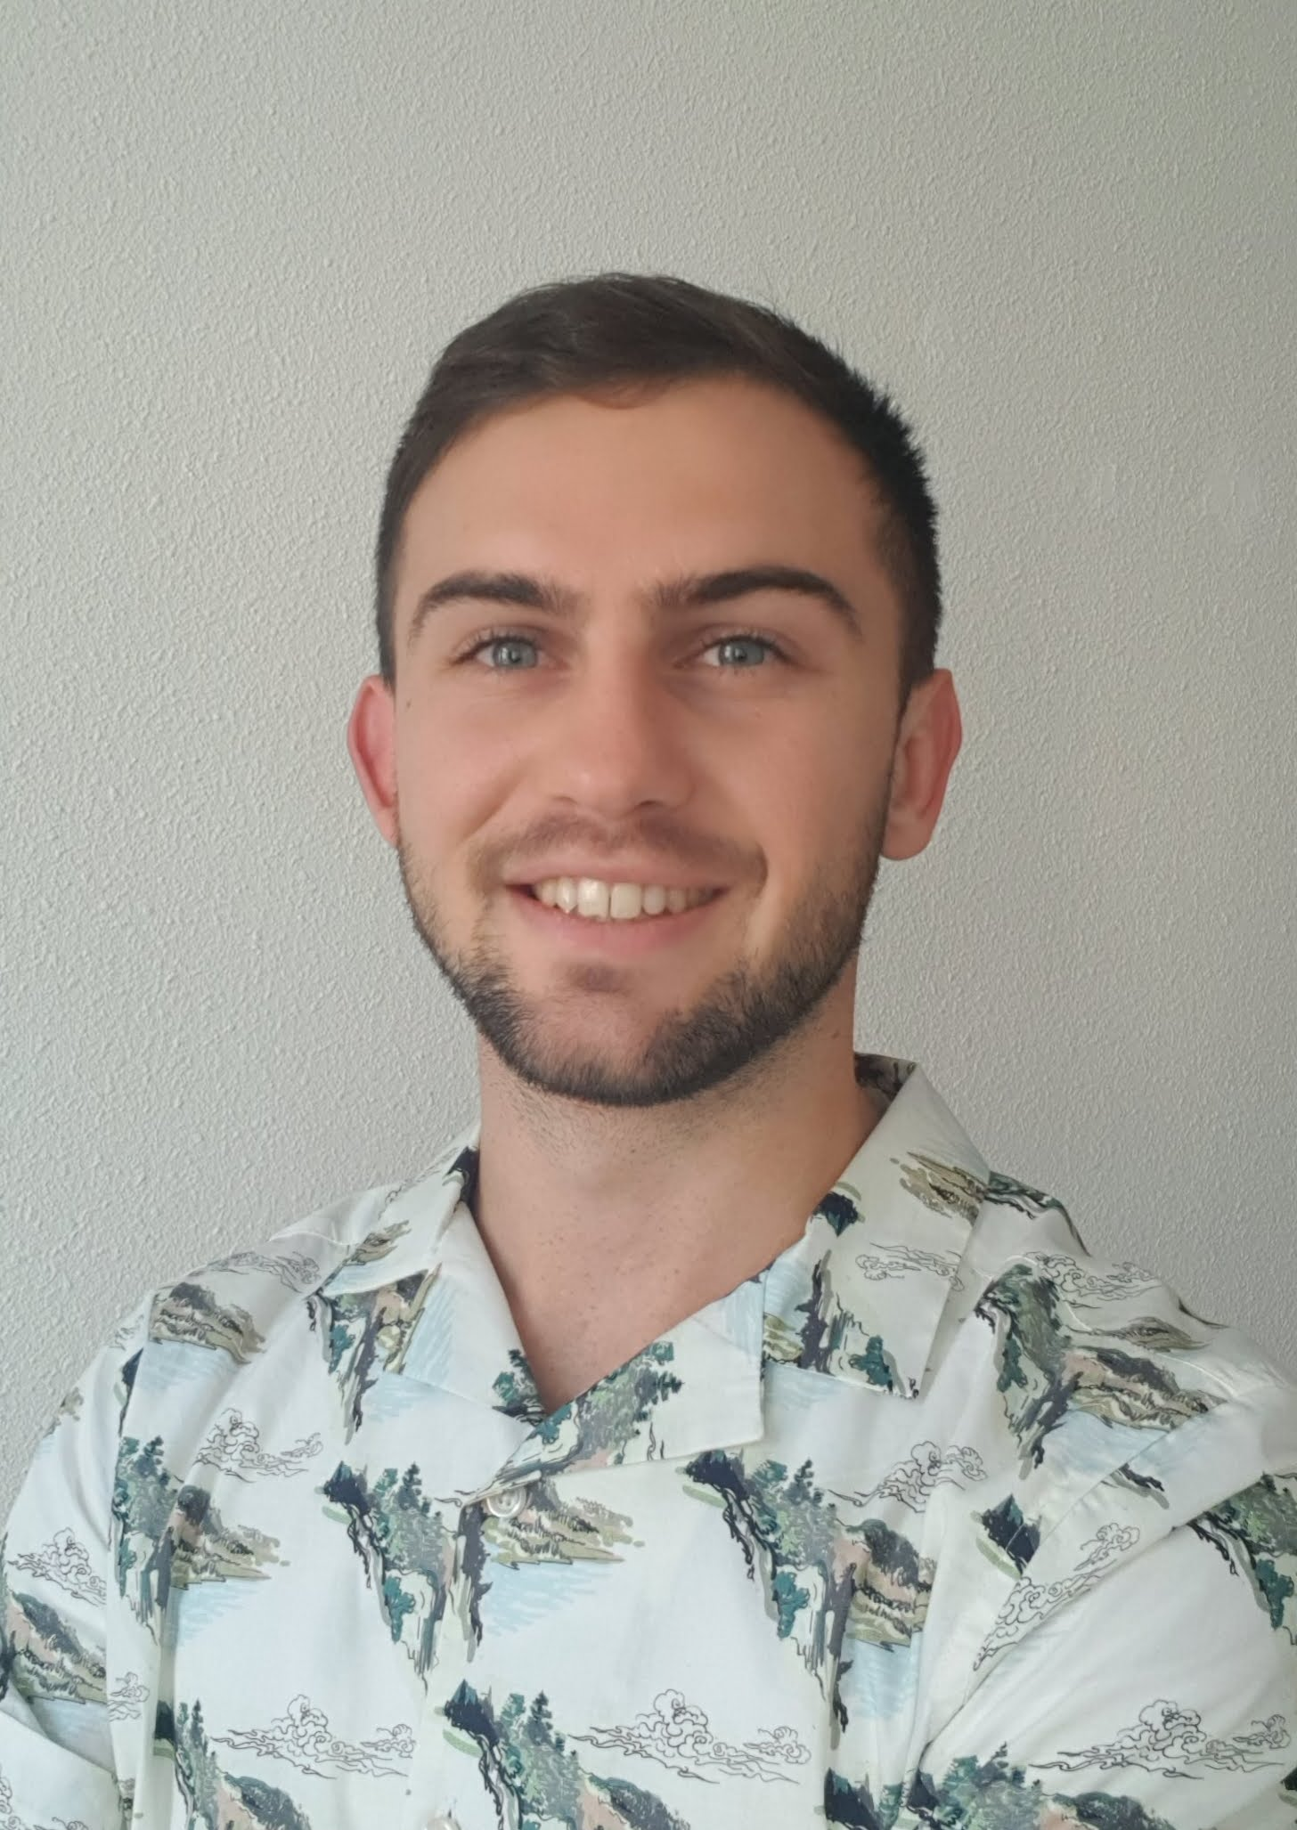
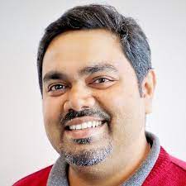

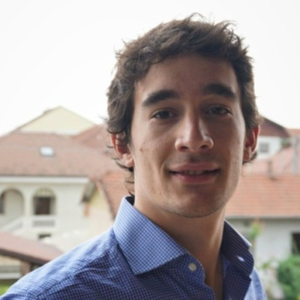
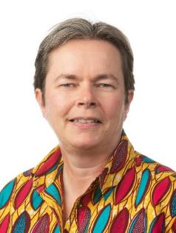
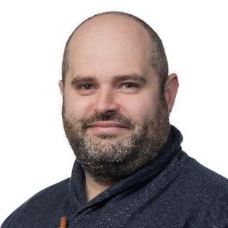
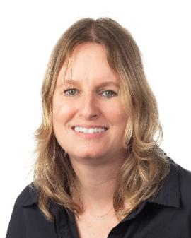
WCDI seed systems thematic cluster
Abishkar Subedi
Gareth Borman
Walter de Boef
Johann Bonnand
Arnab Gupta
Falaq Tidjani
Carlo Cucchi
Mirjam Schaap
James Mulkerrins
Marja Thijssen

Slide 11
2023 portfolio seed systems projects |  | Years | Donors
1 | Integrated seed sector development in Africa | 2018-2023 | SDC & others
3 | Building food system resilience in protracted crisis – Seed systems in South Sudan | 2019-2023 | DGIS
4 | ISSD Sahel (Mali & Niger) | 2020-2024 | DGIS
5 | Collaborative Seed Programme, Nigeria | 2020-2024 | DGIS
6 | TMT – OKP South Sudan & ICP Horti Somaliland courses | 2020-2023 | Nuffic
7 | Resilient seed system phase II project | 2021-2023 | LNV
8 | Ethiopia-Netherlands Seed Partnership | 2021-2024 | DGIS
9 | Guide for designing national seed road maps | 2022-2023 | NFP & WCDI
10 | Seed sector assessment Egypt | 2022-2023 | FNS-EKN funding
11 | Various assessments for SeedNL | 2023 | FNS-EKN funding
12 | Seed sector assessment Bangladesh | 2023 | RVO
13 | Embracing South-South seed and knowledge sharing for resilient agroecosystems and improved livelihoods: South Sudan and Uganda | 2023-2026 | FAO-ITPGRFA BSF
14 | Special issue seed systems, Journal Agricultural Systems | 2023-2024 | Internal
15 | Two annual international plant genetic resources and seed related courses | Annual | Nuffic

Slide 12
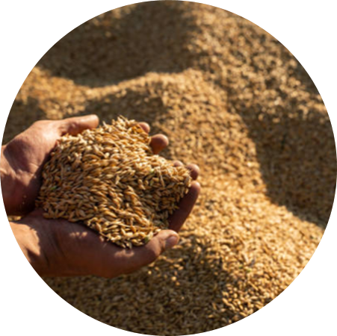
Thank you!
Marja Thijssen, PhD
Wageningen Centre for Development Innovation
Email: marja.thijssen@wur.nl
Walter de Boef, PhD
Wageningen Centre for Development Innovation
Email: walter.deboef@wur.nl
Image courtesy: Vecteezy.com

